Slide 1
Becoming the first Java 11 Certified Developer
Jeanne Boyarsky
Wednesday, March 6, 2019
Dev Nexus

Slide 2
At end of session
https://speakerdeck.com/boyarsky
https://github.com/boyarsky/2019-dev-nexus-java-11-cert

Slide 3
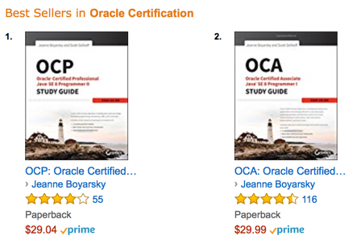
About Me
17 years as
Java Developer
Book random giveway at end!!!

Slide 4
Disclaimer
A bit of the material is from our first books.
Some of the material in this presentation may appear in our upcoming certification books.
Oracle can announce anything (I don’t work for Oracle.)

Slide 5

Introductions
Notes:
Image from https://pixabay.com/de/vectors/mann-person-junge-cartoon-lächeln-158404/

Slide 6
Agenda
Module | Topics
1 | Intro, _, private methods in interfaces
2 | effectively final try with resources, var
3 | Collections and Strings
4 | Single file execution, deprecation and JShell
5 | Streams
6 | Jigsaw, Multi release jar files
7 | Study tips, harder questions/review

Slide 7
Module flow
Review lab from previous module
Lecture
Practice questions as a group/discussion
Hands on exercises
10 minute break
This means if a colleague needs to call you, the last 15-20 minutes of each hour is best.

Slide 8
Labs
I will sprinkle in some concepts form earlier version of Java into the labs. (ex: reading from a file).
If you are not familiar with these, it is fine to Google or ask me.

Slide 9
Focus
Focus is Java 11 changes
Will still throw in Java 8 and earlier content and tricks
Pretend any Word smart quotes are normal double quotes.

Slide 10
Module 1
Intro
_
private methods in interfaces

Slide 11
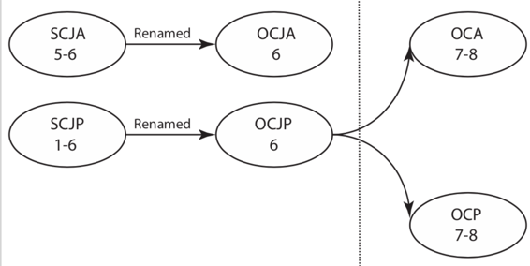
Exam History
+ upgrade

Slide 12
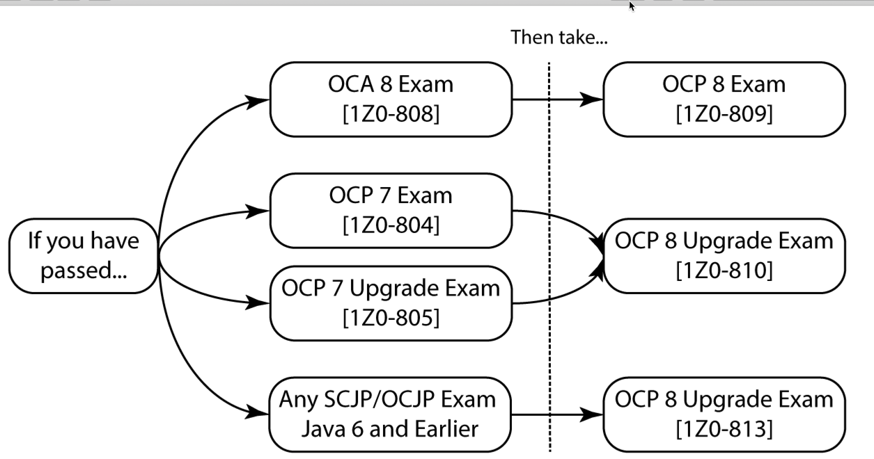
Exam History

Slide 13
Cert Expectations
Why helps your job
Why helps your knowledge
How relates to real world coding

Slide 14
Beta Cert Expectations
More questions
Sometimes no right answer
Can leave comments
Few study materials

Slide 15
Which version should I use?
Java | Oracle JDK | Open JDK
New version | Every 3 years | Every 6 months
Cost | Paid | Free
Upgrade Options | Next version Security patch Open JDK | Interim security patch Next version

Slide 16
Expectations for Java 11
Two exams
LTS versions of Java
Cert site reorg – beta page gone

Slide 17
Dates from last time
 | Java 8 | Java 11
Release | March 18, 2014 | Sept 25, 2018
Objectives/beta announced | August 31, 2014 | March 2019?
Beta opens | April 28, 2015 | ???
Retirement of previous Java exams | Java 6 – May 31, 2018 Java 7 – Dec 30, 2018 | Java 8 - ???

Slide 18
Required Software for Today
Java 11 – if don’t have: https://jdk.java.net/11/
Text editor of your choice
No IDE!
No syntax highlighting!

Slide 19
Optional: Aliases
alias javac11=/Library/Java/JavaVirtualMachines/jdk-11.0.2.jdk/Contents/Home/bin/javac
alias java11=/Library/Java/JavaVirtualMachines/jdk-11.0.2.jdk/Contents/Home/bin/java
alias jshell11=/Library/Java/JavaVirtualMachines/jdk-11.0.2.jdk/Contents/Home/bin/jshell

Slide 20
Underscores
Single _ no longer a valid identifier
Double underscore valid
Underscore and letters valid
Why? Positioning for future

Slide 21
Private methods
Private and private static methods allowed in interfaces
Why? Can write other code so maintainability

Slide 22
Allowed in Interfaces
Type | Scope
Constants | Public
Abstract Methods | Public
Default Methods | Public
Static Methods | Public or private
Instance methods | Private

Slide 23
Module 1 – Question 1
Which of the following compile?
String abc = null;
String 123 = null;
String () = null;
String __ = null;
String _ = null;
Notes:
A,D

Slide 24
Module 1 – Question 2
Which can fill in the blank?
interface TheInterface {
____ int method() { return 1; } }
public
protected
no modifier
private
None of the above
Notes:
D

Slide 25
Module 1 – Question 3
Which can fill in the blank?
interface TheInterface {
____ static void method() {} }
public
protected
no modifier
private
None of the above
Notes:
A,C,D

Slide 26
Module 1 – Question 4
Which of the following compile?
String _a = null;
String _1 = null;
String $ = null;
String _ = null;
String __ = 1;
Notes:
A,C

Slide 27
Module 1 – Question 5
Which can fill in the blank?
interface TheInterface {
____ default void method() {} }
public
protected
no modifier
private
None of the above
Notes:
A,C,D

Slide 28
Module 1 – Question 6
Which of the following compile?
double d = 1_0;
double d = 1.0;
double d_d = 1_0;
double _d_ = _1_;
double _ = 1_;
Notes:
A,B,C

Slide 29
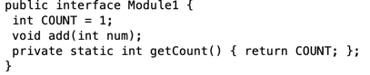
Module 1 – Question 7
How many identifiers could have independently been changed to _ in Java 10?
0
1-2
3-4
5 or more
None – code does not compile
Notes:
D

Slide 30


Lab & Break
See handout
Notes:
Image from https://www.maxpixel.net/Clipart-Boy-Science-Cartoon-Lab-Experiments-Vitro-2841726 and https://www.publicdomainpictures.net/en/view-image.php?image=238196&picture=woman-drinking-coffee

Slide 31
Module 2
Review lab
effectively final try with resources
var

Slide 32
Review lab
Why didn’t calling getRandom() work?
How did you fix it?
What version of Java disallowed _?
When would you use private interface methods in real life?
Notes:
getRandom() is private so can’t be called outside interface
Java 9 bans _

Slide 33
Effectively Final Definition
If typed final before param/local variable
and it would still compile

Slide 34
Which are effectively final?
public int numChairs = 4;
public int numLegs = numChairs * 4;
numChairs++;
System.out.println(numChairs);

Slide 35
Try with Resources - Before
Path path = Paths.get("file");
try(BufferedReader reader =
Files.newBufferedReader(path)){
// read file
}

Slide 36
Try with Resources - After
Path path = Paths.get("file");
BufferedReader reader =
Files.newBufferedReader(path);
try(reader){
// read file
}

Slide 37
What’s wrong here?
Connection con =
DriverManager.getConnection(url);
PreparedStatement ps =
con.prepareStatement(sql);
ps.setInt(1, id);
ResultSet rs = ps.executeQuery();
try (con; ps; rs) {
while (rs.next()) {
// process result set
} }
Resource leak!
Twitter: @jeanneboyarsky
Notes:
http://openjdk.java.net/jeps/225

Slide 38
String name = "Jeanne”;
var name = "Jeanne";
List list = List.of(1, 2, 3);
var list = List.of(1, 2, 3);
Syntactical sugar/less boilerplate
Not immutable (no val)

Slide 39
var name = "Jeanne";
String name2 = name;
Compiled code same with var

Slide 40
List<WebElement> headers = thead.findElements(By.tagName("th"));
VolunteerDashboardRow headerRow = new VolunteerDashboardRow(headers);
vs
var headers = thead.findElements(By.tagName("th"));
var headerRow = new VolunteerDashboardRow(headers);
Notes:
Point out scanability

Slide 41
var csvPath = createAndGetFile(CSV_DATA);
try (var csvWriter =
Files.newBufferedWriter(csvPath);
var csvPrinter = new
CSVPrinter(csvWriter,
CSVFormat.DEFAULT)); {
}

Slide 42
Map<Integer, String> productMap1
= new HashMap<Integer, String>();
Map<Integer, String> productMap2
= new HashMap<>();
var productMap3
= new HashMap<Integer, String>();
Notes:
Not always less typing

Slide 43
Where can we use?
var name = "Jeanne";
var other = name + 2;
var list = List.of(1, 2, 3);
for (var num : list) {}

Slide 44
Where can’t we use?
class Inner { var bad = "abc"; }
var noGood;
noGood = 4;
Also instance variables, etc

Slide 45
Does this work?
var var = "var";

Slide 46
Pros | Cons
Less typing | Loss of information
Less redundancy | Variable names matter more
Can scan variable names | Be careful!
http://openjdk.java.net/projects/amber/LVTIstyle.html

Slide 47
Lambdas
Predicate<String> pred1
= p -> true;
Predicate<String> pred2
= (String p) -> true;
Predicate<String> pred3
= (var p) -> true;
Notes:
Useful for annotation

Slide 48
Annotations
BiPredicate<
Map<Integer, String>,
List<String>> func =
(@NotNull var map, var list) -> true;
Notes:
Useful for annotation

Slide 49
All or nothing
Good
(var map, var list) -> true
No good
(var map, list) -> true
(var map, List list) -> true
Notes:
Useful for annotation

Slide 50
Module 2 – Question 1
Which are true if the resources are ResultSets?
try (resource1; resource2) {}
Resource 1 is closed before resource 2
Resource 2 is closed before resource 1
Neither is closed since declared before try
The code does not compile
Notes:
B

Slide 51
Module 2 – Question 2
What is the output?
var a = 1; var b = a;
int c = b; System.out.println(c);
a does not compile
b does not compile
c does not compile
1
None of the above
Notes:
D

Slide 52
Module 2 – Question 3
Which are true if the resources are ResultSets?
try (resource1, resource2) {}
Resource 1 is closed before resource 2
Resource 2 is closed before resource 1
Neither is closed since declared before try
The code does not compile
Notes:
D (should be semicolon)

Slide 53
Module 2 – Question 4
What is the output?
var a = 1; var b = a;
double c = b; System.out.println(c);
a does not compile
b does not compile
c does not compile
1.0
None of the above
Notes:
D

Slide 54
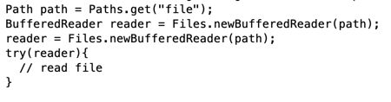
Module 2 – Question 5
Which is true at the end of the code block?
Reader is closed
Reader remains open
None; the code does not compile
Notes:
C

Slide 55
Module 2 – Question 6
What is the output?
var a = 1; var b = a;
String c = b; System.out.println(c);
a does not compile
b does not compile
c does not compile
1
None of the above
Notes:
C

Slide 56
Module 2 – Question 7
Which variable declarations compile?
var a = null; var b = 1;
var c; var var = 3;
a
b
c
var
Notes:
B and D

Slide 57
Module 2 – Question 8
Which variable declarations compile?
var a; a = 1; static var b = 1;
int x=1, var y=1; var VAR = 1;
a
b
y
VAR
Notes:
D

Slide 58
Module 2 – Question 9
Which allow using var?
Inner class instance variables
Lambda variables
Static variables
Try with resources
Notes:
B, D

Slide 59
Lab & Break
See handout
Notes:
Image from https://www.maxpixel.net/Clipart-Boy-Science-Cartoon-Lab-Experiments-Vitro-2841726 and https://www.publicdomainpictures.net/en/view-image.php?image=238196&picture=woman-drinking-coffee

Slide 60
Module 3
Review lab
Collections
Strings

Slide 61
Review lab
How did it go?
Anyone want to share their solutions?
What did you think of the local variable type inference paper?

Slide 62
Creating a non-empty Set
Set<String> set = new HashSet<>(
Arrays.asList("1","2", "3"));
Set<String> set = Stream.of("1", "2”, "3")
.collect(Collectors.toSet());
Set<String> set = Set.of("1", "2", "3");
Notes:
http://openjdk.java.net/jeps/269
https://pixabay.com/p-485050/?no_redirect

Slide 63
For consistency
List<String> list = List.of("1", "2", "3");
Up to 10 params, then varargs
Map<String, String> map = Map.of("k", "v");
Up to 20 params, then varargs
Notes:
http://openjdk.java.net/jeps/269
https://pixabay.com/p-485050/?no_redirect

Slide 64

Better Map
Map<Integer, Integer> map =
Map.ofEntries(
Map.entry(1, 10),
Map.entry(2, 20)
);
Notes:
http://openjdk.java.net/jeps/269
https://pixabay.com/p-485050/?no_redirect
https://upload.wikimedia.org/wikipedia/commons/thumb/a/a5/Map_of_USA_with_state_names.svg/2000px-Map_of_USA_with_state_names.svg.png

Slide 65
Lists
Not equivalent!
List.of(1, 2, 3)
Arrays.asList(1, 2, 3)
Only one is immutable
Demo in JShell

Slide 66
Streams
Terminal operators:
toUnmodifiableList()
toUnmodifiableSet()
toUnmodifiableMap()

Slide 67
Whitespace
trim()
strip()
stripLeading()
stripTrailing()
isBlank()
<-- Legacy – not Unicode aware

Slide 68
Repeating
"123 ".repeat(3).length();
"".repeat(3).length();

Slide 69
Streams
"abc\n123"
.lines()
.count();
"abc".chars()
.count();

Slide 70
Module 3 – Question 1
What does the following output?
Map<Integer, Integer> map
= Map.of(1, 2, 3, 4);
System.out.println(map.get(2));
1
2
null
Code does not compile
Throws exception
Notes:
C

Slide 71
Module 3 – Question 2
What does the following output?
long count = "java\n".repeat(5).lines().count();
System.out.println(count);
4
5
6
Code does not compile
Throws exception
Notes:
B

Slide 72
Module 3 – Question 3
What does the following output?
Map<Integer> map
= Map.of(1, 2, 3, 4);
System.out.println(map.get(2));
1
2
null
Code does not compile
Throws exception
Notes:
D

Slide 73
Module 3 – Question 4
What does the following output?
long count = "\n".strip().repeat(5).lines().count();
System.out.println(count);
0
1
5
Code does not compile
Throws exception
Notes:
A

Slide 74
Module 3 – Question 5
What does the following output?
Map<Integer, Integer> map
= Map.of(1, 2, 3);
System.out.println(map.get(2));
1
2
null
Code does not compile
Throws exception
Notes:
D

Slide 75
Module 3 – Question 6
Which can fill in the blank to print 0?
System.out.println(
"\t"._____().length());
strip()
stripFirst()
stripLast()
trim()
None of the above
Notes:
A, B, C, D

Slide 76
Module 3 – Question 7
What does the following output?
List<Integer> list = List.of(1, 2, 3);
list.remove(2);
System.out.println(list);
[1, 2, 3]
[1, 3]
[1, 2]
Code does not compile
Throws exception
Notes:
E

Slide 77
Module 3 – Question 8
Which can fill in the blank to print 1?
System.out.println(
"a\t"._____().length());
strip()
stripLeading()
stripTrailing()
trim()
None of the above
Notes:
A, C, D

Slide 78
Module 3 – Question 9
What does the following output?
List list = Arrays.asList(1, 2, 3);
list.remove(2);
System.out.println(list);
[1, 2, 3]
[1, 3]
[1, 2]
Code does not compile
Throws exception
Notes:
E

Slide 79
Module 3 – Question 10
Which can fill in the blank to print 1?
char whitespace = '\u001D';
String str = whitespace + "x";
System.out.println(
str.________().length());
stripLeading()
stripTrailing()
strip()
None of the above
Notes:
A and C

Slide 80
Module 3 – Question 11
What does the following output?
List list = Arrays.asList(1, 2, 3);
list.set(1, 0);
System.out.println(list);
[1, 0, 3]
[1, 2, 3]
null
Code does not compile
Throws exception
Notes:
A

Slide 81
Module 3 – Question 12
Which can fill in the blank to print 1?
char whitespace = '\t';
String str = whitespace + "x";
System.out.println(
str.________().length());
stripLeading()
stripTrailing()
trim()
None of the above
Notes:
A,C

Slide 82
Module 3 – Question 13
What does the following output?
List<Integer> list = List.of(1, 2, 3);
list.set(1, 0);
System.out.println(list);
[1, 0, 3]
[1, 2, 3]
null
Code does not compile
Throws exception
Notes:
E

Slide 83
Lab & Break
See handout
Notes:
Image from https://www.maxpixel.net/Clipart-Boy-Science-Cartoon-Lab-Experiments-Vitro-2841726 and https://www.publicdomainpictures.net/en/view-image.php?image=238196&picture=woman-drinking-coffee

Slide 84
Module 4
Review lab
Single file execution
Deprecation
JShell

Slide 85
Review lab
Which operations succeeded on Arrays.asList?
Did any operations succeed on List.of?
Why do we need strip(), stripLeading() and stripTrailing()?

Slide 86
New java launcher mode
Full command | Shorthand
javac HelloWorld.java java HelloWorld | java HelloWorld.java
Produces class file | Fully in memory
For any program | For programs with one file

Slide 87
“Launch Single-File Source-Code”
Designed to reduce ceremony
For students learning Java
Quick experiments
Can have multiple classes in same file
Can use built in Java classes

Slide 88
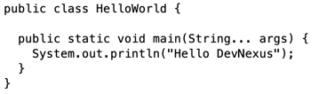
Simple Example
java HelloWorld

Slide 89
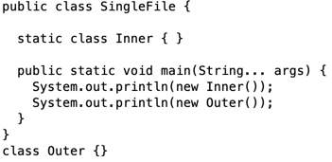
Multiple Classes
java SingleFile.java

Slide 90
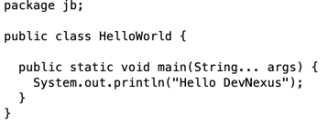
Packages
java jb/HelloWorld.java

Slide 91
Deprecated (was on OCP)
Finalize
Constructor for wrapper classes
(Nashorn)
deprecated for removal/since

Slide 92
@Deprecated
“Very few deprecated APIs were actually removed, leading some people to believe that nothing would ever be removed.
On the other hand, other people believed that everything that was deprecated might eventually be removed, which was never the intent either.”
From JEP 277
Notes:
http://openjdk.java.net/jeps/277

Slide 93
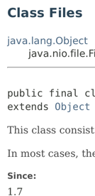
@Deprecated New Attributes
Attribute | Type | Description
forRemoval | boolean | Is the intent to remove API from Java at some point?
since | String | Version of Java when API first became deprecated (not populated for all pre-Java 9 APIs)
Only had for new
APIs before
Notes:
http://openjdk.java.net/jeps/277

Slide 94
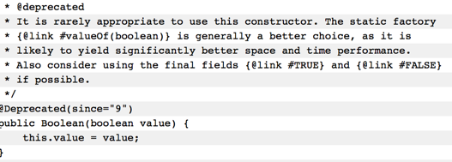
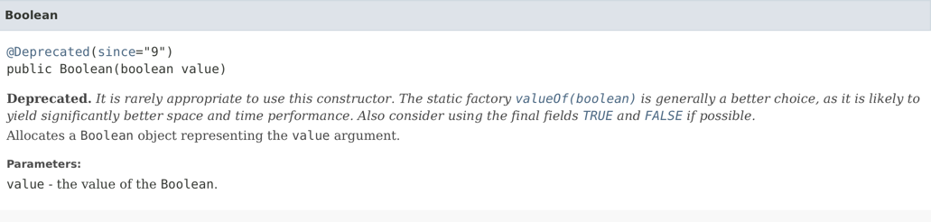
Notes:
http://openjdk.java.net/jeps/277

Slide 95
@Deprecated
Warning types
Ordinary Deprecation
Removal
@SuppressWarnings("deprecation”)
@SuppressWarnings("removal”)
@SuppressWarnings({"deprecation", "removal"})
Notes:
http://openjdk.java.net/jeps/277

Slide 96
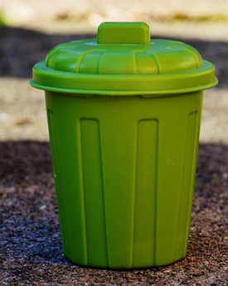
What is deprecated for removal?
Unused code in AWT
Some old security APIs
Some thread and runtime APIs
Some Jigsaw transition modules
(but not classes)
And…
Notes:
http://download.java.net/java/jdk9/docs/api/deprecated-list.html
https://pixabay.com/p-1111448/?no_redirect

Slide 97

Applets
Finally deprecated!
But…
forRemoval=false
Applet
Notes:
http://openjdk.java.net/jeps/289
https://upload.wikimedia.org/wikipedia/commons/thumb/4/41/Argentina_-_NO_symbol.svg/2000px-Argentina_-_NO_symbol.svg.png

Slide 98
JShell
Probably not on exam
You may (or may not) like it for prototyping
Live demo

Slide 99
Module 4 – Question 1
Which is a valid way to run a Java program?
java HelloWorld
java HelloWorld.java
javac HelloWorld.java java HelloWorld
javac HelloWorld.java java HelloWorld.class
Notes:
B, C

Slide 100
Module 4 – Question 2
Which of the following can run this program?
public class Module4 {
public static void main(String... args) {}
}
java Test.java
java Test
Neither
Notes:
A

Slide 101
Module 4 – Question 3
Which of the following can run this program?
package x;
public class Module4 {
public static void main(String[] args) {} }
java Test
java x.Test.java
java x/Test.java
java x/Test
None of the above
Notes:
C

Slide 102
Module 4 – Question 4
Which of the following can run this program?
public class Module4 {
public static void main(String[] args) {
java.util.List l = null; } }
java Test
java Test.java
Neither
Notes:
B

Slide 103
Module 4 – Question 5
Which of the following can run this program?
public class Module4 {
public static void main(String[] args) {
x.MyClass c = null; } }
java Test
java Test.java
Neither
Notes:
C

Slide 104
Module 4 – Question 6
Which of the following can run this program?
public class Module4 {}
java Test
java Test.java
Neither
Notes:
C

Slide 105
Module 4 – Question 7
What are the default deprecation values?
forRemoval = false, since = null
forRemoval = true, since = null
forRemoval = false, since = 1.9
forRemoval = true, since = 1.9
Notes:
A

Slide 106
Lab & Break
See handout
Notes:
Image from https://www.maxpixel.net/Clipart-Boy-Science-Cartoon-Lab-Experiments-Vitro-2841726 and https://www.publicdomainpictures.net/en/view-image.php?image=238196&picture=woman-drinking-coffee

Slide 107
Module 5
Review lab
Streams

Slide 108
Review lab
What error did you get running MathUtils?
What error did you get running JavaDemo?
What did you think of JShell?

Slide 109
Streams - ofNullable
Optional.ofNullable() existed since Java 8
stream = dubiousObj == null
? Stream.empty()
: Stream.of(dubiousObj);
stream = Stream.ofNullable(dubiousObj);

Slide 110
Streams - iterate
Stream.iterate(10, i-> i-1)
.limit(10)
.forEach(System.out::println);
Stream.iterate(10, i-> i>0, i-> i-1)
.forEach(System.out::println);

Slide 111
Streams - takeWhile
Stream.iterate(1, i-> i< 10, i-> i + 1)
.takeWhile(i -> i < 5)
.forEach(System.out::println);
Assumes ordered stream. Takes all elements until one doesn’t match. So prints the numbers 1-4

Slide 112
Streams - takeWhile
How print all Fibonacci #s less than 30?
Stream.iterate(
new SimpleEntry<Integer, Integer>(1,1),
e -> new SimpleEntry<Integer,Integer>(
e.getValue(), e.getKey()+e.getValue()))
.map(Entry::getValue)
.takeWhile(n -> n < 30)
.forEach(System.out::println);

Slide 113
Streams - dropWhile
Stream.iterate(1, i-> i< 10, i-> i + 1)
.dropWhile(i -> i < 5)
.forEach(System.out::println);
Assumes ordered stream. Takes all elements until one doesn’t match. So prints the numbers 5-9

Slide 114
Streams - dropWhile
Stream.iterate(new SimpleEntry<Integer, Integer>(1,1),
e -> new SimpleEntry<Integer, Integer>(
e.getValue(), e.getKey()+e.getValue()))
.map(Entry::getValue)
.dropWhile(n -> n < 30)
.forEach(System.out::println);
Note: This doesn’t work. takeWhile and dropWhile aren’t always opposites.
Notes:
Drops prefix and then goes on infinitely

Slide 115
Module 5 – Question 1
What does the following output?
long count = Stream
.iterate(1; i-> i< 10; i-> i+2).count();
System.out.println(count);
0
5
10
The code does not compile
None of the above
Notes:
D (semi-colons not commas)

Slide 116
Module 5 – Question 2
What does the following output?
Stream.iterate(1, i-> i< 10, i-> i++)
.takeWhile(i -> i < 5)
.forEach(System.out::println);
The numbers 1-4
The numbers 5-9
An infinite stream
The code does not compile
None of the above
Notes:
C (i++ doesn’t update anything)

Slide 117
Module 5 – Question 3
What does the following output?
long count = Stream
.iterate(1, i-> i< 10, i-> i+2).count();
System.out.println(count);
0
5
10
The code does not compile
None of the above
Notes:
B

Slide 118
Module 5 – Question 4
What does the following output?
long count = Stream.ofNullable(null).count();
System.out.println(count);
0
1
null
The code does not compile
None of the above
Notes:
A

Slide 119
Module 5 – Question 5
What does the following output?
Stream.iterate(1, i-> i< 10, i-> ++i)
.dropWhile(i -> i < 5)
.forEach(System.out::println);
The numbers 1-4
The numbers 5-9
An infinite stream
The code does not compile
None of the above
Notes:
B

Slide 120
Module 5 – Question 6
What does the following output?
long count = Stream.of(null).count();
System.out.println(count);
0
1
null
The code does not compile
None of the above
Notes:
E

Slide 121
Lab & Break
See handout
Notes:
Image from https://www.maxpixel.net/Clipart-Boy-Science-Cartoon-Lab-Experiments-Vitro-2841726 and https://www.publicdomainpictures.net/en/view-image.php?image=238196&picture=woman-drinking-coffee

Slide 122
Module 6
Review lab
Jigsaw
Multi-release jars

Slide 123
Review lab
Questions?
What was hardest?
Who wants to share their work?

Slide 124
Jigsaw basics
Module system
JDK is modularized

Slide 125
Simple module
/src
/package1
/module-info.class
/MyClass.class

Slide 126
Module info
module moduleName
requires otherModuleName;
exports packageName;

Slide 127
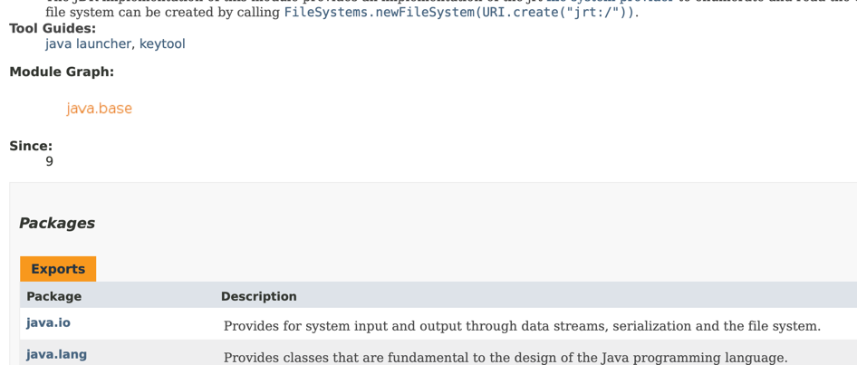
Base Module
https://docs.oracle.com/en/java/javase/11/docs/api/java.base/module-summary.html

Slide 128
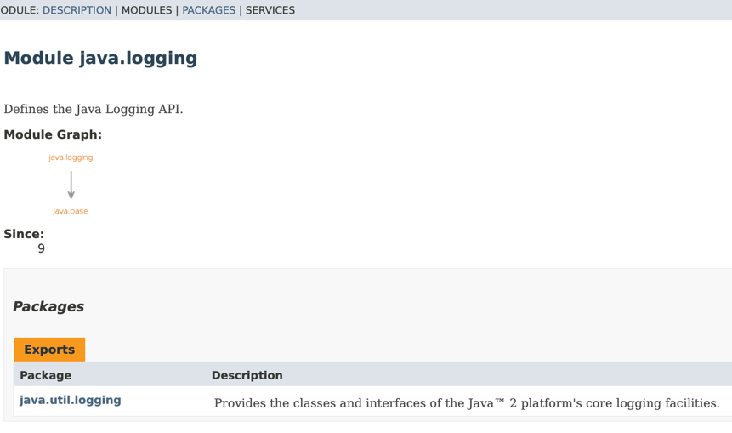
Module graph
https://docs.oracle.com/en/java/javase/11/docs/api/java.logging/module-summary.html

Slide 129
Module file “commands”
Requires – dependencies
Requires transitive – grant to caller
Exports – share package
Opens – for reflection

Slide 130
Module implications
java.base available by default
Can have “private” package
No circular dependencies

Slide 131
Sample
https://docs.oracle.com/en/java/javase/11/docs/api/java.base/module-summary.html

Slide 132
Multi-Release Jar
/MyClass1.class
/META-INF
/MANIFEST.MF Multi-Release: true
/versions
/11
/MyClass1.class

Slide 133
Java Versions
Override “default” files with latest version found
Can specify Java 9+ explicitly
If don’t specify, uses “default” files
Java 8 will use “default” files

Slide 134
Multi Version Order
Java 8 | Java 9 | Java 10 | Java 11
Default | 9 | 10 | 11
 | Default | 9 | 10
 |  | Default | 9
 |  |  | Default

Slide 135
Uses
Alternate API
More efficient implementations
Not coupled to lowest version of Java in Prod

Slide 136
Module 6 – Question 1
What is the maximum number of multi-version folders you can currently have the are version specific?
1
2
3
Notes:
C

Slide 137
Module 6 – Question 2
What is the name of the property to enable multi-release jars?
MultiRelease=on
MultiRelease=true
Multi-Release=on
Multi-Release=true
None of the above
Notes:
D

Slide 138
Module 6 – Question 3
Which module command allows callers to access a package?
exports
opens
reflects
requires
None of the above
Notes:
A

Slide 139
Module 6 – Question 4
What is the name of the folder for multi-release files?
files
multiRelease
multi-release
versions
None of the above
Notes:
D

Slide 140
Module 6 – Question 5
How many modules are available by default?
0
1
2
3
4
Notes:
B

Slide 141
Module 6 – Question 6
Which module command allows reflection?
exports
opens
reflects
requires
None of the above
Notes:
B

Slide 142
Module 6 – Question 7
What is the name of the property to enable multi-release jars?
MultiRelease=on
MultiRelease=true
Multi-Release=on
Multi-Release=true
None of the above
Notes:
D

Slide 143
Lab & Break
See handout
Notes:
Image from https://www.maxpixel.net/Clipart-Boy-Science-Cartoon-Lab-Experiments-Vitro-2841726 and https://www.publicdomainpictures.net/en/view-image.php?image=238196&picture=woman-drinking-coffee

Slide 144
Module 7
Review lab
Study tips
Harder questions

Slide 145
Review lab
What did you observe creating the multi module jar?
What flag did you use to specify version?
How many modules are built in? Which look most useful?
Did anyone succeed in packaging a module?
Notes:
70
Java.base
Java.logging
Java.sql

Slide 146
Preparing for the Exam
Even if for Java 8
Study Guide (ex: Mine!)
Mock Exams (ex: Enthuware)
Study at least 15 minutes a day (advice courtesy of Bert Bates)
Create a plan (even if don’t follow)

Slide 147
Preparing for the Exam
Code snippets
Memorize and write down that day
How do use practice questions

Slide 148
Day of the Exam
Writing instrument and materials
Time management
Flagging questions and multiple passes
Don’t leave any blank!

Slide 149
After the Exam
Celebrate!
Tweet me your success ☺.

Slide 150
Almost the end...
Ten more questions.
Keep track of how well you do!

Slide 151
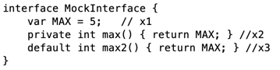
Module 7 – Question 1
Which is true?
Line x1 doesn’t compile
Line x2 doesn’t compile
Line x3 doesn’t compile
MAX is accessible to implementing classes
max2() is accessible to implementing classes
Notes:
A

Slide 152
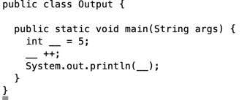
Module 7 – Question 2
What is output
when run
java Output.java?
5
6
Code does not compile
Code throws an exception at runtime
Notes:
D (main method incorrect)

Slide 153
Module 7 – Question 3
Which is true of modules?
A single class can be exported.
A single package can be exported
They require a module-def file
They require a module-info file
None of the above
Notes:
B, D

Slide 154
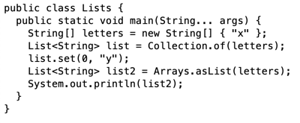
Module 7 – Question 4
What is output
when run
java Lists.java?
[x]
[y]
Code does not compile
Code throws an exception at runtime
Notes:
C (Collection.of does not exist)

Slide 155
Module 7 – Question 5
Where can you use var with try with resources?
For an effectively final variable used in a try with resources declaration
In the catch declaration
In an instance variable referenced by the body of the try with resources
In a try with resources declaration
Notes:
A, D

Slide 156
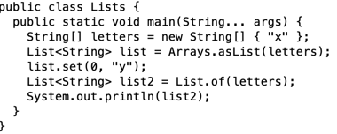
Module 7 – Question 6
What is output
when run
java Lists.java?
[x]
[y]
Code does not compile
Code throws an exception at runtime
Notes:
B

Slide 157
Module 7 – Question 7
Which is true of multi-release jars?
An older version of Java will ignore folders for newer versions.
Newer versions are designated with a version folder in the root directory
They can be unzipped in WinZip
You can create a “8” folder for Java 8 projects.
Notes:
A, C

Slide 158
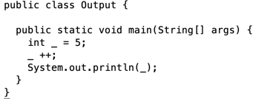
Module 7 – Question 8
What is output
when run
java Output.java?
5
6
Code does not compile
Code throws an exception at runtime
Notes:
C

Slide 159
Module 7 – Question 9
Which are true statements?
If strip() returns true, trim() will always return true.
If stripLeading() returns true, trim() will always return true.
If trim() returns true, strip() will always return true.
If trim() returns true, stripLeading() will always return true.
Notes:
C

Slide 160
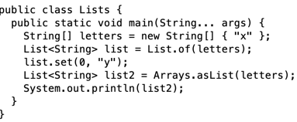
Module 7 – Question 10
What is output
when run
java Lists.java?
[x]
[y]
Code does not compile
Code throws an exception at runtime
Notes:
D

Slide 161
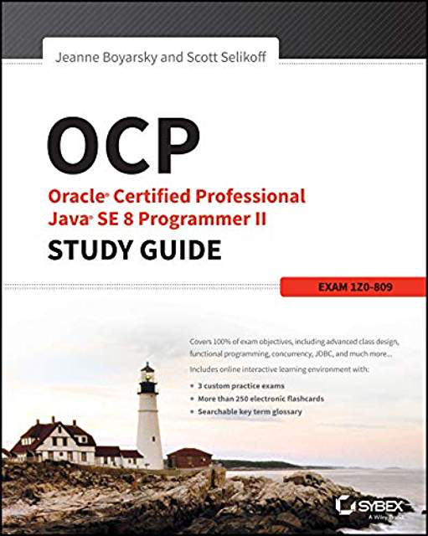
Book giveway

